Slide 1
Operating Systems
Process Scheduling Algorithms

Slide 2
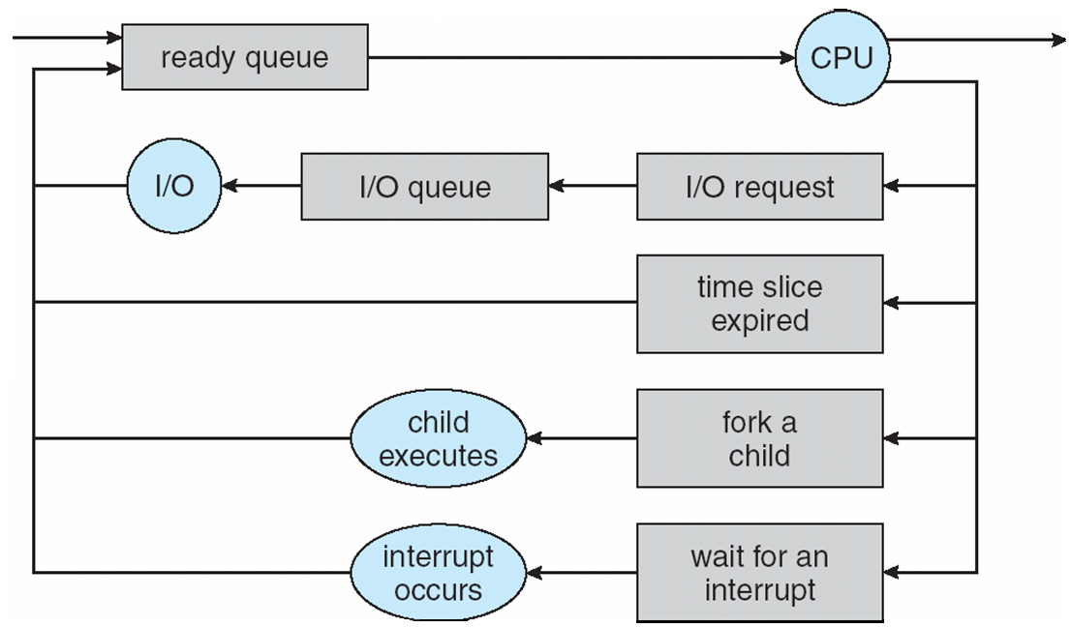
CPU Scheduling
How is the OS to decide which of several tasks to take off a queue?
Scheduling: deciding which threads are given access to resources from moment to moment.

Slide 3
Assumptions about Scheduling
CPU scheduling big area of research in early ‘70s
Many implicit assumptions for CPU scheduling:
  One program per user
  One thread per program
  Programs are independent
These are unrealistic but simplify the problem
Does “fair” mean fairness among users or programs?
  If I run one compilation job and you run five, do you get five times as much CPU?
    Often times, yes!
Goal: dole out CPU time to optimize some desired parameters of the system.
  What parameters?

Slide 4


Assumption: CPU Bursts

Slide 5
Assumption: CPU Bursts
Execution model: programs alternate between bursts of CPU and I/O
  Program typically uses the CPU for some period of time, then does I/O, then uses CPU again
  Each scheduling decision is about which job to give to the CPU for use by its next CPU burst
  With timeslicing, thread may be forced to give up CPU before finishing current CPU burst.

Slide 6
Process Execution Phases
move(A,B)
add(R1,3)
move(R1,A)
load(File_1)
copy(R1,R3)
sub(R3,5)
move(R3,B)
store(File_1)
div(B,2)
move(B,A)
CPU-intensive
I/O-intensive
CPU-intensive
I/O-intensive
CPU-intensive

Slide 7

What is Important in a Scheduling Algorithm?

Slide 8
Performance Evaluation Criteria
fairness
  often: CPU time per process
Efficiency/CPU utilization
  resource utilization; often CPU
response time (interactive users)
  start of the process/burst until the first response to the user
turnaround time (batch users)
  start of the process/burst until the end of the process/burst
- The interval from the time of submission of a process to the time of completion is the turnaround time. Waiting to get into memory + waiting in the ready queue + executing on the CPU + doing I/O

Slide 9
Evaluation Criteria (cont.)
throughput
  number of finished processes per time unit
waiting time
  time spent in the ready queue
context switches
  indication for the amount of overhead
complexity of the scheduling algorithm
  indication of the time needed to select the next process

Slide 10
What is Important in a Scheduling Algorithm?
Minimize Response Time
  Elapsed time to do an operation (job)
  Response time is what the user sees
    Time to echo keystroke in editor
    Time to compile a program
    Real-time Tasks: Must meet deadlines imposed by World
Maximize Throughput
  Jobs per second
  Throughput related to response time, but not identical
    Minimizing response time will lead to more context switching than if you maximized only throughput
  Minimize overhead (context switch time) as well as efficient use of resources (CPU, disk, memory, etc.)
Fairness
  Share CPU among users in some equitable way
  Not just minimizing average response time

Slide 11
Scheduling
deals with the allocation of resources to processes
  CPU scheduling
  disk scheduling
important aspects
  when does a process get a resource
  how long may the process keep the resource
  how are conflicting requests resolved

Slide 12
Scheduling of Processes
long-term scheduling (job scheduling)
  a process is added to the pool of processes
  medium-term scheduling
  a process is swapped in or out of main memory
short-term scheduling
  which process will get the CPU
  invoked in the following situations
    a process is done with its task or CPU burst
    a process has an I/O request
    the time slice of a process is over
    a new process with a higher priority arrives
    possibly after an interrupt

Slide 13
Factors in Scheduling
is the process CPU- or I/O-bound
interactive or batch
process priority
execution time used so far
execution time required to complete
preemption frequency
page fault frequency

Slide 14
CPU Scheduler
component of the operating system
  is itself a process
  uses resources of the computer system
    in particular CPU time, memory
  should not consume too much CPU time
    otherwise the overhead is too high

Slide 15
CPU Scheduler (cont.)
responsible for the selection of the next process to be executed
the selection is done according to a scheduling algorithm
short-term scheduling of processes
  job scheduler and mid-term scheduler also schedule processes, but with a longer-term perspective
  basic principles are similar for all three process schedulers

Slide 16
Preemptive & non preemptive Scheduling
CPU-scheduling decisions may take place under the following four circumstances:
When a process switches from the running state to the waiting state (for example, as the result of an I/0 request or an invocation of wait for the termination of one of the child processes)
When a process switches from the running state to the ready state (for example, when an interrupt occurs)
When a process switches from the waiting state to the ready state (for example, at completion of I/0)
When a process terminates

Slide 17
Scheduling Algorithm
prescribes the way the next process is selected
determines the order in which processes are executed
defines the actions for the scheduler

Slide 18
Scheduling Algorithms
types of scheduling algorithms
  preemptive, non-preemptive
instances of scheduling algorithms
  FCFS, SJF, SRTF, priority-based, round robin
  multilevel, multilevel feedback

Slide 19
Non-Preemptive Scheduling
a process stays on the CPU until it voluntarily releases the CPU
  long waiting and response times
  may lead to starvation
simple, easy to implement
not suited for multi-user systems
euphemism: “cooperative multitasking”

Slide 20
Preemptive Scheduling
the execution of a process may be interrupted by the operating system at any time
  interrupt
  higher priority process
    arrival of a new process, change of status
  time limit
prevents a process from using the CPU for too long
may lead to race conditions
  can be solved by using process synchronization

Slide 21
Context Switch
removal of the “old” process from the CPU
  saves the process block in main memory
selection of the next process
  see scheduling
installation of the “new” process in the CPU
  read the process block from main memory
  set the program counter, registers, etc.
  (re-)start the process

Slide 22
Dispatcher
transfer of control to the newly selected process
  context switch
  switch to user mode
  continue execution of the process at the position indicated by the program counter
dispatch latency
  the time it takes to stop one process and start the execution of another one

Slide 23
First-Come, First-Served (FCFS)
principle
  processes are served in the order
  in which they arrive
  even if they have the same arrival time, an order of arrival is distinguishable, or a process is chosen randomly

Slide 24
FCFS Example
five processes arrive at time 0 in the order
P1, P2, P3, P4, P5
processes have different (expected) burst lengths
all processes have the same priority
Gantt chart illustrates the execution of processes on the CPU
comparison criteria with other algorithms
  waiting time
  response time
  turnaround time
  number of context switches

Slide 25
Terminology
  waiting time
    time a process spends in the ready queue
      not in the waiting queue
    may consist of several separate periods
  response time
    time from the arrival of the process until its first activity
  turnaround time
    time from the arrival until the termination of the process
    usually only one single CPU burst is considered
  number of context switches
    simplified assumption: for each period of CPU activity, a process requires one context switch
    roughly one half context switch to be loaded into the CPU, and another half to be removed

Slide 26
Scheduling Algorithms: First-Come, First-Served (FCFS)
“Run until Done:” FIFO algorithm
In the beginning, this meant one program runs non-preemtively until it is finished (including any blocking for I/O operations)
Now, FCFS means that a process keeps the CPU until one or more threads block
Example: Three processes arrive in order P1, P2, P3.
  P1 burst time: 24
  P2 burst time: 3
  P3 burst time: 3
Draw the Gantt Chart and compute Average Waiting Time and Average Completion Time.

Slide 27
Scheduling Algorithms: First-Come, First-Served (FCFS)
Example: Three processes arrive in order P1, P2, P3.
  P1 burst time: 24
  P2 burst time: 3
  P3 burst time: 3
Waiting Time
  P1: 0
  P2: 24
  P3: 27
Completion Time:
  P1: 24
  P2: 27
  P3: 30
Average Waiting Time: (0+24+27)/3 = 17
Average Completion Time: (24+27+30)/3 = 27
P1
P2
P3
0
24
27
30

Slide 28
Scheduling Algorithms: First-Come, First-Served (FCFS)
What if their order had been P2, P3, P1?
  P1 burst time: 24
  P2 burst time: 3
  P3 burst time: 3

Slide 29
Scheduling Algorithms: First-Come, First-Served (FCFS)
What if their order had been P2, P3, P1?
  P1 burst time: 24
  P2 burst time: 3
  P3 burst time: 3
Waiting Time
  P1: 0
  P2: 3
  P3: 6
Completion Time:
  P1: 3
  P2: 6
  P3: 30
Average Waiting Time: (0+3+6)/3 = 3 (compared to 17)
Average Completion Time: (3+6+30)/3 = 13 (compared to 27)
P2
P3
P1
0
3
6
30

Slide 30
Scheduling Algorithms: First-Come, First-Served (FCFS)
Average Waiting Time: (0+3+6)/3 = 3 (compared to 17)
Average Completion Time: (3+6+30)/3 = 13 (compared to 27)
FIFO Pros and Cons:
  Simple (+)
  Short jobs get stuck behind long ones (-)
    If all you’re buying is milk, doesn’t it always seem like you are stuck behind a cart full of many items
  Performance is highly dependent on the order in which jobs arrive (-)
  Convoy effect(favors long processes compared to shorter ones)

Slide 31
Convoy Effect
A convoy effect happens when a set of processes need to use a resource for a short time, and one process holds the resource for a long time, blocking all of the other processes. Causes poor utilization of the other resources in the system

Slide 32
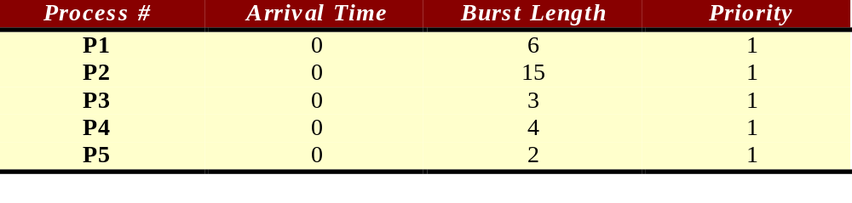
FCFS Example
0
5
10
15
20
25
30

Slide 33
FCFS Example
P1
0
5
10
15
20
25
30

Slide 34
FCFS Example
P1
P2
0
5
10
15
20
25
30

Slide 35
FCFS Example
P1
P2
P3
0
5
10
15
20
25
30

Slide 36
FCFS Example
P1
P2
P3
P4
0
5
10
15
20
25
30

Slide 37
FCFS Example
P1
P2
P3
P4
P5
0
5
10
15
20
25
30

Slide 38
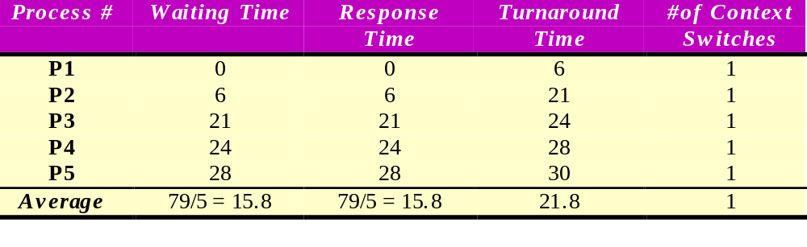
FCFS Example
P1
P2
P3
P4
P5
0
5
10
15
20
25
30

Slide 39
How Can We Improve on This?

Slide 40
Shortest Job First (SJF)
principle:
the process with the shortest CPU burst length is selected
  obvious improvement from FCFS

Slide 41
SJF Example
same conditions as in the FCFS example
  arrival time 0 for all processes
  same priorities
  different (expected) burst lengths

Slide 42
SJF Example
P5
0
5
10
15
20
25
30

Slide 43
SJF Example
P5
P3
0
5
10
15
20
25
30

Slide 44
SJF Example
P5
P3
P4
0
5
10
15
20
25
30

Slide 45
SJF Example
P5
P3
P4
P1
0
5
10
15
20
25
30

Slide 46
SJF Example
P5
P3
P4
P1
P2
0
5
10
15
20
25
30

Slide 47
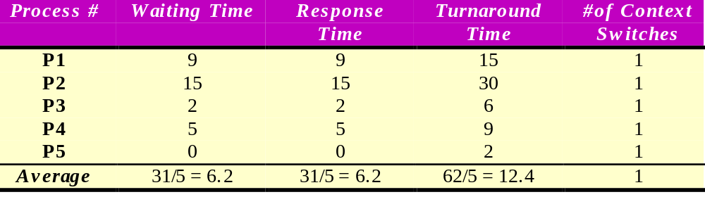
SJF Example
P5
P3
P4
P1
P2
0
5
10
15
20
25
30

Slide 48
SJF Example 2
slight modification
  different arrival times for the processes
  same priorities
  different (expected) burst lengths
  the processes waiting in the ready queue are added
  to the diagram

Slide 49
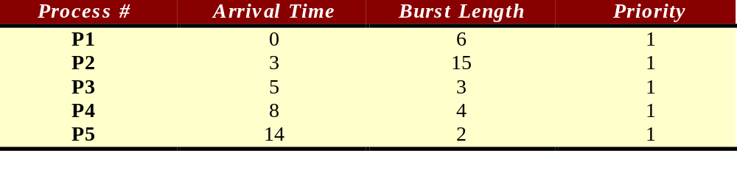
SJF Example 2
P1: 6
ready queue at time 0
0
5
10
15
20
25
30

Slide 50
SJF Example 2
P1: 6
P2: 15
ready queue at time 3
P1
0
5
10
15
20
25
30

Slide 51
SJF Example 2
P2: 15
ready queue at time 5
P1: 6
P2: 15
P3: 3
P1
P3
0
5
10
15
20
25
30

Slide 52
SJF Example 2
P2: 15
P2: 15
P1: 6
P2: 15
P3: 3
P4: 4
P1
P3
P4
0
5
10
15
20
25
30

Slide 53
SJF Example 2
P2: 15
P2: 15
P1: 6
P2: 15
P3: 3
P4: 4
P2: 15
P1
P3
P4
P2
0
5
10
15
20
25
30

Slide 54
SJF Example 2
P2: 15
P2: 15
P1: 6
P2: 15
P3: 3
P4: 4
P2: 15
P5: 2
P1
P3
P4
P2
P5
0
5
10
15
20
25
30

Slide 55
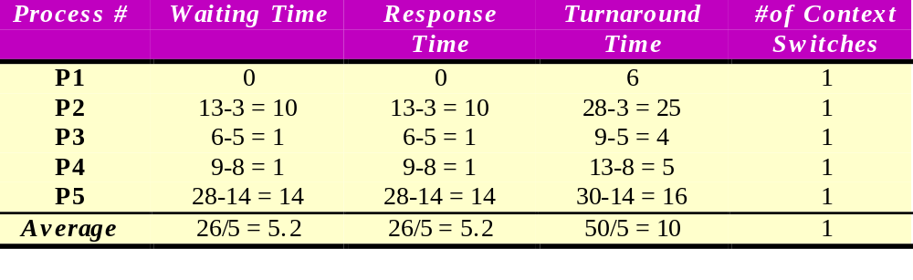
SJF Example 2
P2: 15
P2: 15
P1: 6
P2: 15
P3: 3
P4: 4
P2: 15
P5: 2
P1
P3
P4
P2
P5
0
5
10
15
20
25
30

Slide 56
SJF properties
much better average waiting time than FCFS
  provably optimal with respect to the average waiting time
non-preemptive
relies on knowing the length of the CPU bursts
  in general difficult to impossible
selection is more complex than FCFS
  linear w.r.t. number of processes in the ready queue
starvation is possible
  if new, short processes keep on arriving, old, long processes may never be served

Slide 57
Intermezzo: Burst Length
burst length prediction
burst length estimation
burst length calculation
example

Slide 58
Burst Length Prediction
in practice, the length of the next CPU burst of a process is not known
  as a consequence, algorithms such as SJF, SRTF in their pure form can’t be used in practical systems
the CPU burst length can be estimated based on previous CPU bursts of the process
estimation by analysis
  requires analysis of the code to be executed while the scheduling decision is made
  in general intractable

Slide 59
Burst Length Estimation
the length of the next CPU burst is estimated from the lengths of previous bursts
frequently, recent bursts are given more importance than older bursts
additional overhead during the scheduling decision
  time to calculate the estimates
  memory space to keep values of recent CPU burst lengths

Slide 60
Burst Length Calculation
generic formula to estimate the length of the next CPU burst from the lengths of previous ones
E _{i} = a * B _{i-1} + (1-a) * E _{i-1}
  E _{i} estimate at time i
  B _{i-1} actual burst length at time i-1
  a factor to balance the importance
  of recent and not so recent bursts

Slide 61
Burst Length Example
at time T_{i} we estimate the length of the next CPU burst based on information we have about previous bursts according to
E _{i} = a * B _{i-1} + (1-a) * E _{i-1}
  we have to select a value for a (here 0.75)
  for the very first burst B₀, we have to guess, after that we use the measured time for the previous burst
  the measured burst time may be significantly different from the estimate

Slide 62
Burst Length Example (cont.)
Time Estimate Previous
Burst
T₀ 0.75 * 10 + 0.25 * 0 = 7.5 ---

Slide 63
Burst Length Example (cont.)
Time Estimate Previous
Burst
T₀ 0.75 * 10 + 0.25 * 0 = 7.5 6
T₁ 0.75 * 6 + 0.25 * 7.5 = 6.375

Slide 64
Burst Length Example (cont.)
Time Estimate Previous
Burst
T₀ 0.75 * 10 + 0.25 * 0 = 7.5 6
T₁ 0.75 * 6 + 0.25 * 7.5 = 6.375 3
T₂ 0.75 * 3 + 0.25 * 6.375 = 3.85

Slide 65
Burst Length Example (cont.)
Time Estimate Previous
Burst
T₀ 0.75 * 10 + 0.25 * 0 = 7.5 6
T₁ 0.75 * 6 + 0.25 * 7.5 = 6.375 3
T₂ 0.75 * 3 + 0.25 * 6.375 = 3.85 7
T₃ 0.75 * 7 + 0.25 * 3.85 = 6.2

Slide 66
Burst Length Example (cont.)
Time Estimate Previous
Burst
T₀ 0.75 * 10 + 0.25 * 0 = 7.5 6
T₁ 0.75 * 6 + 0.25 * 7.5 = 6.375 3
T₂ 0.75 * 3 + 0.25 * 6.375 = 3.85 7
T₃ 0.75 * 7 + 0.25 * 3.85 = 6.2 12
T₄ 0.75 * 12 + 0.25 * 6.2 = 9.55

Slide 67
Shortest Remaining Time First (SRTF)
principle:
the process with the shortest remaining time
is selected
  remaining time is the CPU burst length minus the time the CPU has already spent serving the process
if a process with a shorter CPU burst length than the remaining time of the current process arrives, the current process is preempted

Slide 68
SRTF Example
arrival time of new processes is important
it is useful to keep track of the processes
currently in the ready queue
  policy used here: preempted processes go to the end of the ready queue
    may depend on the actual implementation
a scheduling decision must be made when
  a process is done with its CPU burst
  a new process arrives in the ready queue

Slide 69
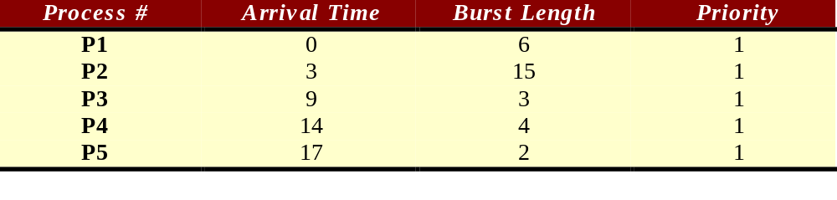
SRTF Example
P1: 6
P1
0
5
10
15
20
25
30

Slide 70
SRTF Example
P1: 3
P1: 6
P2: 15
P1
P1
0
5
10
15
20
25
30

Slide 71
SRTF Example
P1: 3
P1: 6
P2: 15
P2: 15
P1
P1
P2
0
5
10
15
20
25
30

Slide 72
SRTF Example
P1: 3
P2: 12
P1: 6
P2: 15
P2: 15
P3: 3
P1
P1
P2
P3
0
5
10
15
20
25
30

Slide 73
SRTF Example
P1: 3
P2: 12
P1: 6
P2: 15
P2: 15
P3: 3
P2: 12
P1
P1
P2
P3
P2
0
5
10
15
20
25
30

Slide 74
SRTF Example
P1: 3
P2: 12
P2: 10
P1: 6
P2: 15
P2: 15
P3: 3
P2: 12
P4: 4
P1
P1
P2
P3
P2
P4
0
5
10
15
20
25
30

Slide 75
SRTF Example
P4: 1
P1: 3
P2: 12
P2: 10
P5: 2
P1: 6
P2: 15
P2: 15
P3: 3
P2: 12
P4: 4
P2: 10
P1
P1
P2
P3
P2
P4
0
5
10
15
20
25
30

Slide 76
SRTF Example
P4: 1
P1: 3
P2: 12
P2: 10
P5: 2
P5: 2
P1: 6
P2: 15
P2: 15
P3: 3
P2: 12
P4: 4
P2: 10
P2: 10
P1
P1
P2
P3
P2
P4
P5
0
5
10
15
20
25
30

Slide 77
SRTF Example
P4: 1
P1: 3
P2: 12
P2: 10
P5: 2
P5: 2
P1: 6
P2: 15
P2: 15
P3: 3
P2: 12
P4: 4
P2: 10
P2: 10
P2: 10
P1
P1
P2
P3
P2
P4
P5
P2
0
5
10
15
20
25
30

Slide 78
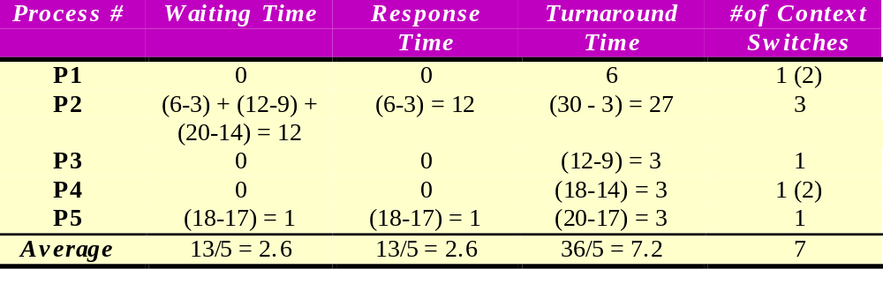
SRTF Example
P4: 1
P1: 3
P2: 12
P2: 10
P5: 2
P5: 2
P1: 6
P2: 15
P2: 15
P3: 3
P2: 12
P4: 4
P2: 10
P2: 10
P2: 10
P1
P1
P2
P3
P2
P4
P5
P2
0
5
10
15
20
25
30

Slide 79
SRTF Properties
good response time for short processes
  attractive for multi-user systems
preemptive version of the SJF algorithm
  higher overhead (context switches, elapsed time table)
starvation possible
impractical due to burst length prediction problem

Slide 80
Highest Response Ratio Next
principle
  priority of a process is a function of its execution time and the time it has been waiting for service
  priority = (time waiting + execution time) / execution time

Slide 81
HRNN Properties
non-preemptive in its basic form
  preemptive variations exist
preference for shorter processes over longer ones
aging ensures that long processes will eventually get the CPU
still requires estimation of the execution time (burst length)
minimum priority = 1.0

Slide 82
Round Robin (RR) Scheduling
FCFS Scheme: Potentially bad for short jobs!
  Depends on submit order
  If you are first in line at the supermarket with milk, you don’t care who is behind you; on the other hand…
Round Robin Scheme
  Each process gets a small unit of CPU time (time quantum)
    Usually 10-100 ms
  After quantum expires, the process is preempted and added to the end of the ready queue
  Suppose N processes in ready queue and time quantum is Q ms:
    Each process gets 1/N of the CPU time
    In chunks of at most Q ms
    What is the maximum wait time for each process?

Slide 83
Round Robin (RR) Scheduling
FCFS Scheme: Potentially bad for short jobs!
  Depends on submit order
  If you are first in line at the supermarket with milk, you don’t care who is behind you; on the other hand…
Round Robin Scheme
  Each process gets a small unit of CPU time (time quantum)
    Usually 10-100 ms
  After quantum expires, the process is preempted and added to the end of the ready queue
  Suppose N processes in ready queue and time quantum is Q ms:
    Each process gets 1/N of the CPU time
    In chunks of at most Q ms
    What is the maximum wait time for each process?
      No process waits more than (n-1)q time units

Slide 84

Round Robin (RR) Scheduling
Round Robin Scheme
  Each process gets a small unit of CPU time (time quantum)
    Usually 10-100 ms
  After quantum expires, the process is preempted and added to the end of the ready queue
  Suppose N processes in ready queue and time quantum is Q ms:
    Each process gets 1/N of the CPU time
    In chunks of at most Q ms
    What is the maximum wait time for each process?
      No process waits more than (n-1)q time units
Performance Depends on Size of Q
  Small Q => interleaved
  Large Q is like…
  Q must be large with respect to context switch time, otherwise overhead is too high (spending most of your time context switching!)

Slide 85
Round Robin (RR) Scheduling
Round Robin Scheme
  Each process gets a small unit of CPU time (time quantum)
    Usually 10-100 ms
  After quantum expires, the process is preempted and added to the end of the ready queue
  Suppose N processes in ready queue and time quantum is Q ms:
    Each process gets 1/N of the CPU time
    In chunks of at most Q ms
    What is the maximum wait time for each process?
      No process waits more than (n-1)q time units
Performance Depends on Size of Q
  Small Q => interleaved, Q must be greater than the context switch time, otherwise overhead is too high.
  Large Q is like FCFS
  Q must be large with respect to context switch time, otherwise overhead is too high (spending most of your time context switching!)

Slide 86
Example of RR with Time Quantum = 4
Process Burst Time
P₁ 24
P₂ 3
P₃ 3
The Gantt chart is:
P₁
P₂
P₃
P₁
P₁
P₁
P₁
P₁
0
4
7
10
14
18
22
26
30

Slide 87
Example of RR with Time Quantum = 4
Process Burst Time
P₁ 24
P₂ 3
P₃ 3
Waiting Time:
  P1: (10-4) = 6
  P2: (4-0) = 4
  P3: (7-0) = 7
Completion Time:
  P1: 30
  P2: 7
  P3: 10
Average Waiting Time: (6 + 4 + 7)/3= 5.67
Average Completion Time: (30+7+10)/3=15.67
P₁
P₂
P₃
P₁
P₁
P₁
P₁
P₁
0
4
7
10
14
18
22
26
30

Slide 88

Time Quantum & Context Switches

Slide 89

Turnaround Time Varies With The Time Quantum
As can be seen from this graph, the average turnaround time of a set
of processes does not necessarily improve as the time quantum size
increases. In general, the average turnaround time can be improved
if most processes finish their next CPU burst in a single time quantum.

Slide 90
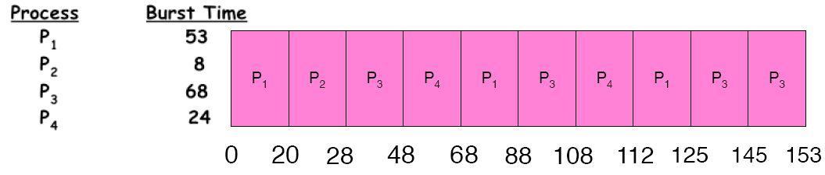
Example of RR with Time Quantum = 20
Waiting Time:
  P1: (68-20)+(112-88) = 72
  P2: (20-0) = 20
  P3: (28-0)+(88-48)+(125-108) = 85
  P4: (48-0)+(108-68) = 88
Completion Time:
  P1: 125
  P2: 28
  P3: 153
  P4: 112
Average Waiting Time: (72+20+85+88)/4 = 66.25
Average Completion Time: (125+28+153+112)/4 = 104.5
A process can finish before the time quantum expires, and release the CPU.

Slide 91

RR Summary
Pros and Cons:
  Better for short jobs (+)
  Fair (+)
  Context-switching time adds up for long jobs (-)
    The previous examples assumed no additional time was needed for context switching – in reality, this would add to wait and completion time without actually progressing a process towards completion.
    Remember: the OS consumes resources, too!
If the chosen quantum is
  too large, response time suffers
  infinite, performance is the same as FIFO
  too small, throughput suffers and percentage overhead grows
Actual choices of timeslice:
  UNIX: initially 1 second:
    Worked when only 1-2 users
    If there were 3 compilations going on, it took 3
    seconds to echo each keystroke!
  In practice, need to balance short-job
  performance and long-job throughput:
    Typical timeslice 10ms-100ms
    Typical context-switch overhead 0.1ms – 1ms (about 1%)

Slide 92
Comparing FCFS and RR
Assuming zero-cost context
switching time, is RR always
better than FCFS?
Assume 10 jobs, all start at the
same time, and each require
100 seconds of CPU time
RR scheduler quantum of 1
second
Completion Times (CT)
  Both FCFS and RR finish at the same time
  But average response time is much worse under RR!
    Bad when all jobs are same length
Also: cache state must be shared between all jobs with RR but can be devoted to each job with FIFO
  Total time for RR longer even for zero-cost context switch!
Job # | FCFS CT | RR CT
1 | 100 | 991
2 | 200 | 992
… | … | …
9 | 900 | 999
10 | 1000 | 1000

Slide 93

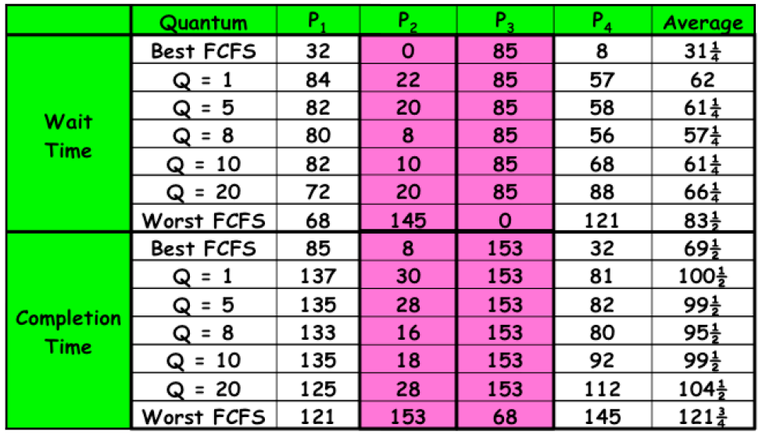
Comparing FCFS and RR

Slide 94
Scheduling
The performance we get is somewhat dependent on what “kind” of jobs we are running (short jobs, long jobs, etc.)
If we could “see the future,” we could mirror best FCFS
Shortest Job First (SJF) a.k.a. Shortest Time to Completion First (STCF):
  Run whatever job has the least amount of computation to do
Shortest Remaining Time First (SRTF) a.k.a. Shortest Remaining Time to Completion First (SRTCF):
  Preemptive version of SJF: if a job arrives and has a shorter time to completion than the remaining time on the current job, immediately preempt CPU
These can be applied either to a whole program or the current CPU burst of each program
  Idea: get short jobs out of the system
  Big effect on short jobs, only small effect on long ones
  Result: better average response time

Slide 95
Scheduling
But, this is hard to estimate
We could get feedback from the program or the user, but they have incentive to lie!
SJF/SRTF are the best you can do at minimizing average response time
  Provably optimal (SJF among non-preemptive, SRTF among preemptive)
  Since SRTF is always at least as good as SJF, focus on SRTF
Comparison of SRTF with FCFS and RR
  What if all jobs are the same length?
  What if all jobs have varying length?

Slide 96
Scheduling
But, this is hard to estimate
We could get feedback from the program or the user, but they have incentive to lie!
SJF/SRTF are the best you can do at minimizing average response time
  Provably optimal (SJF among non-preemptive, SRTF among preemptive)
  Since SRTF is always at least as good as SJF, focus on SRTF
Comparison of SRTF with FCFS and RR
  What if all jobs are the same length?
    SRTF becomes the same as FCFS (i.e. FCFS is the best we can do)
  What if all jobs have varying length?
    SRTF (and RR): short jobs are not stuck behind long ones

Slide 97
Example: SRTF
A or B
C
C I/O
A,B: both CPU bound, run for a week
C: I/O bound, loop 1ms CPU, 9ms disk I/O
If only one at a time, C uses 90% of the disk, A or B could use 100% of the CPU
With FIFO: Once A and B get in, the CPU is held for two weeks
What about RR or SRTF?
  Easier to see with a timeline

Slide 98
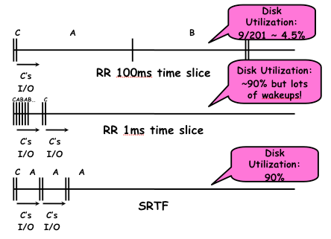
Example: SRTF
A or B
C
C I/O
A,B: both CPU bound, run for a week
C: I/O bound, loop 1ms CPU, 9ms disk I/O

Slide 99
Last Word on SRTF
Starvation
  SRTF can lead to starvation if many small jobs!
  Large jobs never get to run
Somehow need to predict future
  How can we do this?
  Some systems ask the user
    When you submit a job, you have to say how long it will take
    To stop cheating, system kills job if it takes too long
  But even non-malicious users have trouble predicting runtime of their jobs
Bottom line, can’t really tell how long job will take
  However, can use SRTF as a yardstick for measuring other policies, since it is optimal
SRTF Pros and Cons
  Optimal (average response time) (+)
  Hard to predict future (-)
  Unfair, even though we minimized average response time! (-)

Slide 100
Predicting the Future
Back to predicting the future… perhaps we can predict the next CPU burst length?
Iff programs are generally repetitive, then they may be predictable
Create an adaptive policy that changes based on past behavior
  CPU scheduling, virtual memory, file systems, etc.
  If program was I/O bound in the past, likely in the future
Example: SRTF with estimated burst length
  Use an estimator function on previous bursts
  Let T(n-1), T(n-2), T(n-3), …, be previous burst lengths. Estimate next burst T(n) = f(T(n-1), T(n-2), T(n-3),…)
  Function f can be one of many different time series estimation schemes (Kalman filters, etc.)

Slide 101
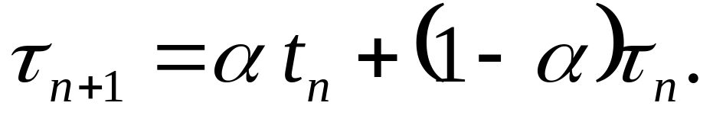

Determining Length of Next CPU Burst
Can only estimate the length
Can be done by using the length of previous CPU bursts, using exponential averaging

Slide 102


Predicting the Future

Slide 103
Examples of Exponential Averaging
α =0
  τ_{n+1} = τ_{n}
  Recent history does not count
α =1
  τ_{n+1} = α t_{n}
  Only the actual last CPU burst counts
If we expand the formula, we get:
    τ_{n+1} = α t_{n}+(1 - α)α t_{n} -1 + …
    +(1 - α )^{j} α t_{n} _{-j} + …
    +(1 - α )^{n +1} τ₀
Since both α and (1 - α) are less than or equal to 1, each successive term has less weight than its predecessor

Slide 104
Priority Scheduling
A priority number (integer) is associated with each process.
The SJF algorithm is a special case of the general priority scheduling algorithm.
The CPU is allocated to the process with the highest priority (smallest integer ≡ highest priority)
  Preemptive (if a higher priority process enters, it receives the CPU immediately)
  Nonpreemptive (higher priority processes must wait until the current process finishes; then, the highest priority ready process is selected)
SJF is a priority scheduling where priority is the predicted next CPU burst time
Problem ≡ Starvation – low priority processes may never execute
Solution ≡ Aging – as time progresses increase the priority of the process

Slide 105
Priority Inversion
Consider a scenario in which there are three processes, one with high priority (H), one with medium priority (M), and one with low priority (L).
Process L is running and successfully acquires a resource, such as a lock or semaphore.
Process H begins; since we are using a preemptive priority scheduler, process L is preempted for process H.
Process H tries to acquire L’s resource, and blocks (because it is held by L).
Process M begins running, and, since it has a higher priority than L, it is the highest priority ready process. It preempts L and runs, thus starving high priority process H.
This is known as priority inversion.
What can we do?

Slide 106
Priority Inversion
Process L should, in fact, be temporarily of “higher priority” than process M, on behalf of process H.
Process H can donate its priority to process L, which, in this case, would make it higher priority than process M.
This enables process L to preempt process M and run.
When process L is finished, process H becomes unblocked.
Process H, now being the highest priority ready process, runs, and process M must wait until it is finished.
Note that if process M’s priority is actually higher than process H, priority donation won’t be sufficient to increase process L’s priority above process M. This is expected behavior (after all, process M would be “more important” in this case than process H).

Slide 107
Multi-level Feedback Scheduling
Another method for exploiting past behavior
  Multiple queues, each with different priority
    Higher priority queues often considered “foreground” tasks
  Each queue has its own scheduling algorithm
    E.g. foreground → RR, background → FCFS
    Sometimes multiple RR priorities with quantum increasing exponentially (highest queue: 1ms, next: 2ms, next: 4ms, etc.)
  Adjust each job’s priority as follows (details vary)
    Job starts in highest priority queue
    If entire CPU time quantum expires, drop one level
    If CPU is yielded during the quantum, push up one level (or to top)

Slide 108
Scheduling Details
Result approximates SRTF
  CPU bound jobs drop rapidly to lower queues
  Short-running I/O bound jobs stay near the top
Scheduling must be done between the queues
  Fixed priority scheduling: serve all from the highest priority, then the next priority, etc.
  Time slice: each queue gets a certain amount of CPU time (e.g., 70% to the highest, 20% next, 10% lowest)
Countermeasure: user action that can foil intent of the OS designer
  For multilevel feedback, put in a bunch of meaningless I/O to keep job’s priority high
  But if everyone does this, it won’t work!
  Consider an Othello program, playing against a competitor. Key was to compute at a higher priority than the competitors.
    Put in printf’s, run much faster!

Slide 109
Scheduling Details
It is apparent that scheduling is facilitated by having a “good mix” of I/O bound and CPU bound programs, so that there are long and short CPU bursts to prioritize around.
There is typically a long-term and a short-term scheduler in the OS.
We have been discussing the design of the short-term scheduler.
The long-term scheduler decides what processes should be put into the ready queue in the first place for the short-term scheduler, so that the short-term scheduler can make fast decisions on a good mix of a subset of ready processes.
The rest are held in memory or disk
  Why else is this helpful?

Slide 110
Scheduling Details
It is apparent that scheduling is facilitated by having a “good mix” of I/O bound and CPU bound programs, so that there are long and short CPU bursts to prioritize around.
There is typically a long-term and a short-term scheduler in the OS.
We have been discussing the design of the short-term scheduler.
The long-term scheduler decides what processes should be put into the ready queue in the first place for the short-term scheduler, so that the short-term scheduler can make fast decisions on a good mix of a subset of ready processes.
The rest are held in memory or disk
  This also provides more free memory for the subset of ready processes given to the short-term scheduler.

Slide 111
Fairness
What about fairness?
  Strict fixed-policy scheduling between queues is unfair (run highest, then next, etc.)
    Long running jobs may never get the CPU
    In Multics, admins shut down the machine and found a 10-year-old job
  Must give long-running jobs a fraction of the CPU even when there are shorter jobs to run
    Tradeoff: fairness gained by hurting average response time!
How to implement fairness?
  Could give each queue some fraction of the CPU
    i.e., for one long-running job and 100 short-running ones?
    Like express lanes in a supermarket – sometimes express lanes get so long, one gets better service by going into one of the regular lines
  Could increase priority of jobs that don’t get service (as seen in the multilevel feedback example)
    This was done in UNIX
    Ad hoc – with what rate should priorities be increased?
    As system gets overloaded, no job gets CPU time, so everyone increases in priority
      Interactive processes suffer

Slide 112
Lottery Scheduling
Yet another alternative: Lottery Scheduling
  Give each job some number of lottery tickets
  On each time slice, randomly pick a winning ticket
  On average, CPU time is proportional to number of tickets given to each job over time
How to assign tickets?
  To approximate SRTF, short-running jobs get more, long running jobs get fewer
  To avoid starvation, every job gets at least one ticket (everyone makes progress)
Advantage over strict priority scheduling: behaves gracefully as load changes
  Adding or deleting a job affects all jobs proportionally, independent of how many tickets each job possesses

Slide 113
Example: Lottery Scheduling
Assume short jobs get 10 tickets, long jobs get 1 ticket
What percentage of time does each long job get? Each short job?
What if there are too many short jobs to give reasonable response time
  In UNIX, if load average is 100%, it’s hard to make progress
  Log a user out or swap a process out of the ready queue (long term scheduler)

Slide 114
Example: Lottery Scheduling
Assume short jobs get 10 tickets, long jobs get 1 ticket
What if there are too many short jobs to give reasonable response time
  In UNIX, if load average is 100%, it’s hard to make progress
  Log a user out or swap a process out of the ready queue (long term scheduler)
# short jobs / # long jobs | % of CPU each short job gets | % of CPU each long job gets
1/1 | 91% | 9%
0/2 | N/A | 50%
2/0 | 50% | N/A
10/1 | 9.9% | 0.99%
1/10 | 50% | 5%

Slide 115
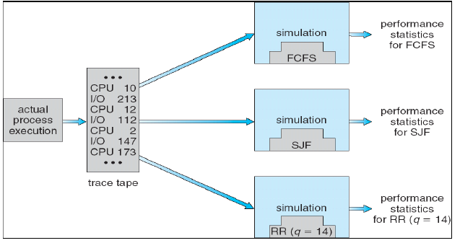
Scheduling Algorithm Evaluation
Deterministic Modeling
  Takes a predetermined workload and compute the performance of each algorithm for that workload
Queuing Models
  Mathematical Approach for handling stochastic workloads
Implementation / Simulation
  Build system which allows actual algorithms to be run against actual data. Most flexible / general.

Slide 116
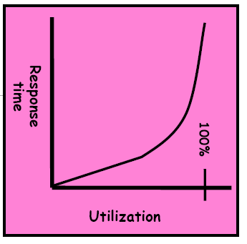
Conclusion
Scheduling: selecting a waiting process
from the ready queue and allocating the
CPU to it
When do the details of the scheduling
policy and fairness really matter?
  When there aren’t enough resources to go around
When should you simply buy a faster computer?
  Or network link, expanded highway, etc.
  One approach: buy it when it will pay for itself in improved response time
    Assuming you’re paying for worse response in reduced productivity, customer angst, etc.
    Might think that you should buy a faster X when X is utilized 100%, but usually, response time goes to infinite as utilization goes to 100%
  Most scheduling algorithms work fine in the “linear” portion of the load curve, and fail otherwise
  Argues for buying a faster X when utilization is at the “knee” of the curve

Slide 117
FCFS scheduling, FIFO Run Until Done:
  Simple, but short jobs get stuck behind long ones
RR scheduling:
  Give each thread a small amount of CPU time when it executes, and cycle between all ready threads
  Better for short jobs, but poor when jobs are the same length
SJF/SRTF:
  Run whatever job has the least amount of computation to do / least amount of remaining computation to do
  Optimal (average response time), but unfair; hard to predict the future
Multi-Level Feedback Scheduling:
  Multiple queues of different priorities
  Automatic promotion/demotion of process priority to approximate SJF/SRTF
Lottery Scheduling:
  Give each thread a number of tickets (short tasks get more)
  Every thread gets tickets to ensure forward progress / fairness
Priority Scheduing:
  Preemptive or Nonpreemptive
  Priority Inversion

